Slide 1

Sync+ 2.0
CD764–Desay_EESE parts
China EESE
Updated on 2022-04-28
Desired Outcome
Awareness
Decision
Escalation Help
Think
Point of view
Plan to Implement
Implement

Slide 2
{R08 PRO HF4} Software overall status {yellow}
Software key info
  Refer SWAD for the details:
    MCU version:20220428_430_PRO
    SoC version:20220428_0677_EL27_R08.PRO.HF4_Debug
    Verification scope and method:
    {Full verification} executed with pass rate 98.22%, 1P1 and 76P2 issues found and not fixed. Refer test report for detail.
Highlights listed below:
    Release Note– refer slide 3
    Open P1 issue list with risk evaluation – refer slide 4
    Open P2 issue list with risk evaluation – refer slide 5
    Open AIMS issue list with risk evaluation – refer slide 6
    Performance Status– refer slide 7/8
    OTA Status– refer slide 9
Notes:
Add P1 weekly burn down chart

Slide 3
{R08 PRO HF4} Release Note
Key | Summary | Priority | AIMS# | Remark
 | 百度地图
APIMCIS-29603 | 100周年动画DTC |  |  | HF4版本验证pass
Notes:
Add P1 weekly burn down chart

Slide 4
{R08 PRO HF4} Open P1 issue list with risk evaluation
Key | Summary | Priority | AIMS# | Remark
APIMCIS-16618 | MMOTA_China:MCU+calibration upgrade, activation fails, F10A cannot be upgraded | Immediate Gating |  | 问题原因：1、setting被KILL导致FOTA crash，这部分改动已修复会合入到下一版本。 2、多VBF升级的具体需求未多方对齐 3、测试所用的VBF文件未签名，导致MCU签名校验失败。需要根据PRO/DEV环境进行对应的签名。 发生概率：100% 恢复机制：不可恢复 风险评估：L
Notes:
Add P1 weekly burn down chart

Slide 5

{R08 PRO HF4} Open P2 issue list with risk evaluation
Gating | 计数项:Status
Awaiting implementation | 18
In Progress | 9
Reopened | 1
Test | 44
To Do | 4
总计 | 76
CD764 R08版本Gating问题修复183个
遗留76个问题有53个会在R09版本修复
Notes:
Add P1 weekly burn down chart

Slide 6

{R08 PRO HF4} Open AIMS issue list with risk evaluation
计数项:Status | 列标签
AIMS | Gating | High | Medium | 总计
Awaiting implementation | 3 |  |  | 3
In Progress | 3 | 3 | 1 | 7
总计 | 6 | 3 | 1 | 10
Notes:
Add P1 weekly burn down chart

Slide 7
{R08 PRO HF4} 性能问题状态
Test Item | R07.1 | R08 HF3 | Test Result | Remark
The time difference from Power Off state to network available车机时间同步完成 | 22.71 | 21.59 | Pass | 较上个版本有优化
The time difference from Power Off state to having the Rear-View-Camera (RVC) system ready respond to PRNDL events (for RVC) | 8.5 | 8.5 | Pass
The time difference from Power Off state to the request for the last Audio source (USB Media) 睡眠后从点火到播放USB音乐声音 | 27.27 | 27.50 | Pass
The time difference from Power Off state to the request for the last Audio source (QQ Music) 睡眠后从点火到播放QQ音乐声音 | 10.9 | 32.0 | Pass
全电台扫描时间 | 8.6 | 8.7 | Pass
已经存在的电台切换 FM to FM/AM to AM | 191.7 | 154.3 | Pass | 较上个版本有优化
网络电台到FM/AM | 1.0 | 1.7 | Pass
BT连接时间，从确认配对到播放BT音乐或者打电话的时间 | 5.20 | 5.35 | Pass
已经配对过的BT设备，从点连接到播放BT音乐或者打电话的时间 | 3.69 | 3.01 | Pass | 较上个版本有优化
同步BT联系人 500条 | 12.38 | 10.86 | Pass | 较上个版本有优化
同步BT联系人 1000条 | 18.65 | 21.45 | Pass
同步BT联系人 1500条 | 54.01 | 30.52 | Pass | 较上个版本有优化
同步BT联系人6000-1W条 | 298.47 | 123.45 | Pass | 较上个版本有优化
从插入u盘开始，扫描前100个USB本地文件后，用户手动选择第一个音乐/视频文件，能够开始播放第一帧的时间 | 1.4 | 0.7 | Pass | 较上个版本有优化
车机拨打、挂断电话后电话状态同步到手机界面的时间。（反之亦然） | 1.72 | 1.52 | Pass | 较上个版本有优化
电话启动时间 (homescreen准备后点击电话按钮到电话应用启动完毕) | 0.70 | 1.68 | Pass
点开WIFI开关后到扫描出所有热点的时间 | 3.5 | 1.5 | Pass | 较上个版本有优化
断开wifi热点的时间 | 143.7 | 192.3 | Pass | 较上个版本有优化
从输入密码到连接成功的时间 | 4.13 | 3.385333333 | Pass
IVI主机运行时，RVC显示时间 | 798.3 | 744.7 | Pass | 较上个版本有优化
从接受到信号到相应HMI status image coding 显示的时间 | 275.0 | 177.3 | Pass | 较上个版本有优化
Notes:
Add P1 weekly burn down chart

Slide 8
{R08 PRO HF4} 性能问题状态
Test Item | R07.1 | R08 HF3 | Test Result | Remark
Power Off to 第一帧动画 (Power off相当于deep sleep) | 8.2 | 8.6 | Fail
The time difference from Power Off state to having the home screen available 冷启动 | 20.7 | 23.0 | Fail
The time difference from Power Off state to having an already paired phone available 车机上重连完成，蓝牙图标显示 | 38.10 | 39.53 | Fail
The time difference from Power Off state to navigation system available for user interaction 打开导航应用 | 55.15 | 46.64 | Fail | 较上个版本有优化
The time difference from Power Off state to PTT ready语音硬按键 | 33.77 | 38.33 | Fail
The time difference from Power Off state to voice recognition ready语音唤醒可用 | 32.127 | 40.800 | Fail
The time difference from Power Off state to USB ready for user interaction ready提示USB设备可用 手动进入U盘音乐（U盘根目录中两首歌曲），看到音乐列表 | 32.4 | 29.9 | Fail | 较上个版本有优化
The time difference from Power Off state to BT media ready for user interaction 开机自动重连手机，手机端查看蓝牙重连时间 | 37.41 | 38.26 | Fail
The time difference from Power Off state to the request for the last Audio source (AM/FM radio) to the Radio (via CAN bus or internal in a shared module) 睡眠后从点火到播放FM声音 | 21.7 | 26.4 | Fail
The time difference from Power Off state to the request for the last Audio source (BT Media) 睡眠后从点火到播放蓝牙音乐声音 | 28.97 | 44.47 | Fail
车辆设置界面-冷启动时间 | 28.71 | 32.75133333 | Fail
空调设置界面-冷启动时间 | 23.23 | 25.63 | Fail
无需输入密码直接连接成功的时间 | 3.93 | 7.55 | Fail
Notes:
Add P1 weekly burn down chart

Slide 9
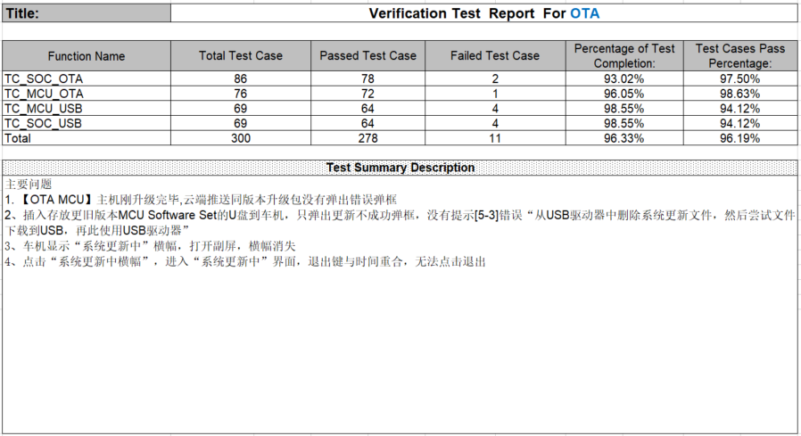
{R08 PRO HF4} OTA测试结果
Notes:
Add P1 weekly burn down chart

